Slide 1

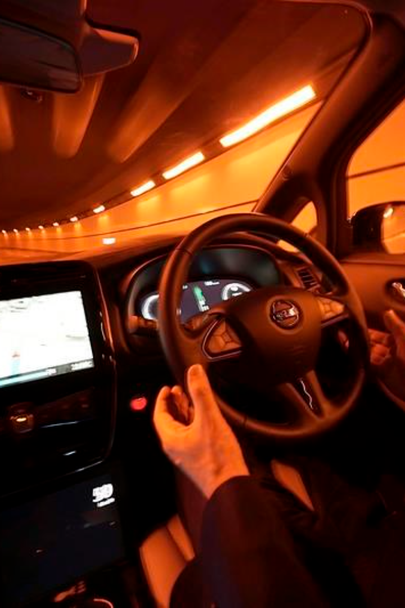
Phase 2: Traffic Management
In this phase, we delve into the exciting world of connected vehicles and how they are revolutionizing traffic management. Explore the cutting-edge technologies that are transforming the way we commute and the future of transportation.

Slide 2

Objective:
This study seeks to explore the synergistic relationship between connected vehicles and Traffic Management using IoT (Internet of Things). It aims to analyze how the integration of IoT technologies into traffic management systems can enhance the effectiveness of connected vehicles in optimizing traffic flow, reducing congestion, and improving overall transportation efficiency. The research will investigate the underlying technological frameworks, data exchange protocols, and real-time monitoring capabilities required for seamless coordination between connected vehicles and IoT-based traffic management systems. By doing so, this study aims to provide valuable insights into the potential of this combined approach to revolutionize modern transportation systems and pave the way for safer, more efficient, and sustainable urban mobility solutions.

Slide 3
Table of Contents
Introduction
Innovative Problem Solution
Sensor Types
Azure IoT Hub
Protocols
Real-Time Traffic Monitoring
Congestion Detection
Route Optimization
Public Platform
Conclusion

Slide 4
Connected Vehicles
1
Connected Vehicles
Learn how connected vehicles are transforming the way we commute and travel, from reducing traffic congestion to enhancing safety.
Automated Driving
2
Discover the advancements in automated driving technology and how it is paving the way for a future with less human error on the roads.
3
Traffic Management
Explore how connected vehicles are enabling innovative traffic management solutions, including real-time data analysis and adaptive traffic control.

Slide 5
Sustainability
Reducing Emissions
Improving Energy Efficiency
Environmental Impact
Learn how IoT technologies are helping us reduce emissions and make our transportation systems more eco-friendly.
Examine the direct and indirect effects of traffic on the environment and how IoT can help us mitigate these impacts.
Discover how smart traffic management systems can optimize energy usage and promote sustainable transportation.

Slide 6
Data Privacy and Security
1
Challenges
Understand the privacy and security challenges associated with IoT-based traffic management systems and how they impact user data.
Solutions
2
Explore the techniques and strategies to ensure data privacy and security in our connected traffic management projects.
3
Regulations
Learn about the regulations and standards that govern the collection and usage of personal data in traffic management systems.

Slide 7

Sensor Types
1
Traffic Sensors
2
Environmental Sensors
Discover the different types of sensors, such as cameras, LIDAR, and radar, used to monitor vehicle flow and congestion.
Explore the role of environmental sensors in assessing the impact of traffic on air quality, temperature, and other factors.
3
GPS Modules
Learn how GPS modules enable real-time vehicle tracking and contribute to comprehensive traffic management systems.

Slide 8
Connecting Sensors
Wired Connections
Wireless Connections
Discover the various ways to connect sensors to our traffic management devices using wired connections for reliable data transmission. With wired connections, you can ensure a stable and secure connection between the sensors and the devices, allowing for accurate and real-time data collection. Learn about different types of wired connections such as Ethernet, serial, and USB, and understand how to set up and maintain these connections.
Explore wireless connectivity options, such as Bluetooth and Wi-Fi, for seamless sensor integration and reduced installation complexity. Wireless connections offer flexibility and scalability, allowing for easy deployment of sensors in various locations without the constraints of physical cables. Learn about the advantages and considerations of wireless connections, and discover the best practices for setting up and managing wireless sensor networks.

Slide 9
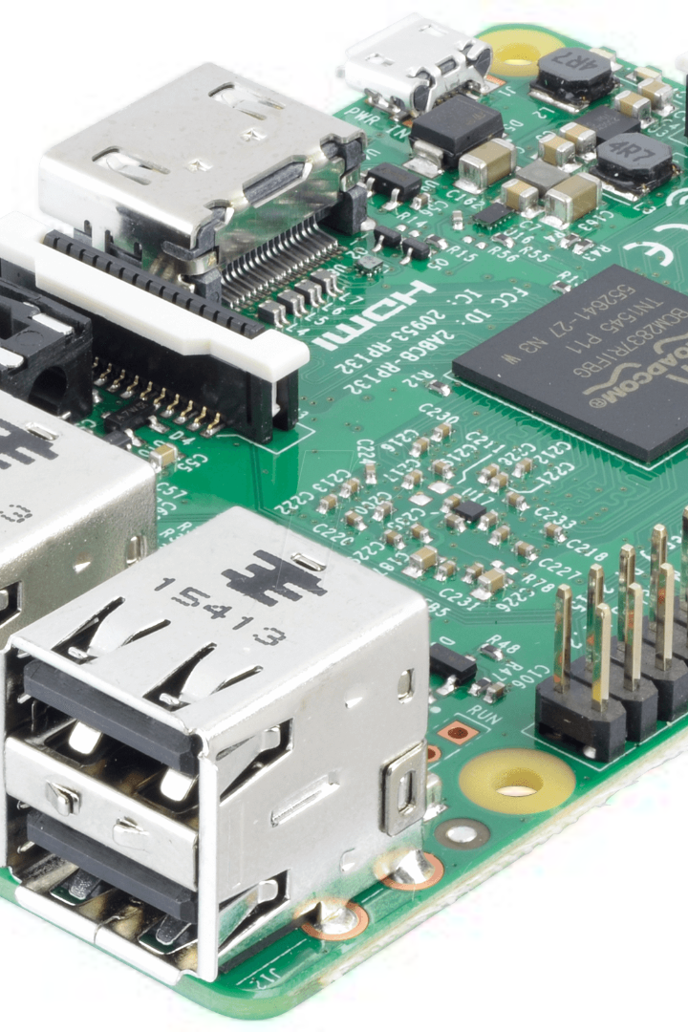
Raspberry Pi
Raspberry Pi is at the core of our local data processing. It receives and analyzes data from various sensors and sends insights to the cloud in real-time. This slide focuses on the role of Raspberry Pi in handling data, providing rapid incident response, and enhancing the overall efficiency of the traffic management system.
Benefits: Local data analysis, real-time data processing, and quicker incident response

Slide 10

Azure IoT Hub
Utilize the power of Azure IoT Hub for secure data storage and analytics. Benefit from its scalable infrastructure analytics capabilities , seamless integration with IoT devices.
1
Scalability
2
Analytics
3
Integration
Effortlessly accommodate increasing volume of traffic data
Leverage advanced algorithm to extract valuable insights
Seamlessly connect with IoT devices for smooth data flow

Slide 11
Protocols
1
MQTT Protocol
Explore the benefits of using MQTT (Message Queuing Telemetry Transport) for efficient and reliable data transmission in IoT traffic management systems.
HTTP Protocol
2
Understand the role of the HTTP (Hypertext Transfer Protocol) in enabling communication between our devices and the cloud servers.
3
API Integration
Learn how API (Application Programming Interface) integration allows us to incorporate external data sources, such as weather and social media, into our traffic management systems.

Slide 12

Real-Time Traffic Monitoring
1
Description
2
Components
3
Benefits
Implement real-time traffic monitoring using cameras, traffic flow sensors, and vehicle detectors.
Sensors: Cameras, traffic flow sensors, vehicle detectors
Improved traffic flow, reduced congestion, and informed decision-making for drivers.
Connectivity: Cellular and Wi-Fi
Cloud (Azure IoT Hub): Centralized data storage and processing
Protocol: MQTT for efficient data transmission
Data Processing: Raspberry Pi for local data analysis

Slide 13

Crowdsourced Data
Explore the power of crowdsourced data by developing a mobile app that allows users to report real-time traffic conditions, complementing traditional data sources for more comprehensive traffic management.

Slide 14

Congestion Detection
1
Description
2
Components
3
Benefits
Employ congestion detection with traffic speed sensors and inductive loop detectors.
Sensors: Traffic speed sensors, inductive loop detectors
Early congestion detection, quicker incident response, and reduced traffic delays.
Connectivity: Cellular and Wi-Fi
Cloud (Azure IoT Hub): Data aggregation and analysis
Protocol: MQTT for real-time data transfer
Data Processing: Raspberry Pi for congestion analysis

Slide 15
Congestion Detection Methods
1
Machine Learning Algorithms
Implement machine learning algorithms to detect congestion based on traffic flow data and social media sentiment analysis, enabling proactive traffic management strategies.
Predictive Congestion Alerts
2
Provide drivers with predictive congestion alerts through a mobile app, suggesting alternative routes to avoid potential traffic jams and delays.

Slide 16

Route Optimization
1
Description
2
Components
3
Benefits
Optimize routes based on real-time traffic data.
Sensors: Real-time traffic data from IoT sensors
Reduced travel time, fuel savings, and minimized environmental impact.
Connectivity: Cellular and Wi-Fi
Cloud (Azure IoT Hub): Data storage and retrieval
Protocol: MQTT for data synchronization
Data Processing: Raspberry Pi for route calculation

Slide 17

Types of Route Optimization
1
Eco-Friendly Routing
Integrate environmental data into route optimization algorithms to reduce the environmental impact of traffic and promote eco-friendly transportation options.
2
Multi-Modal Routing
Suggest routes that combine different transportation modes, such as public transit and cycling, to reduce congestion and provide commuters with flexible and efficient options.

Slide 18
Public Platform
Real-time Traffic Monitoring
Engaging User Experience
Data Analysis and Reporting
Design a user-friendly public-facing website or app interface that provides real-time traffic monitoring with congestion detection and route optimization.
Enhance user engagement by incorporating interactive 3D maps, gamification elements, and community engagement features.
Visualize traffic data and provide comprehensive reporting and analytics tools for users to assess traffic patterns and make informed decisions.

Slide 19
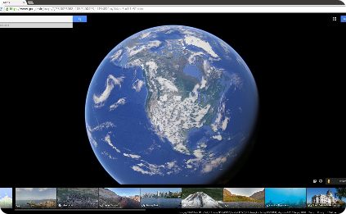
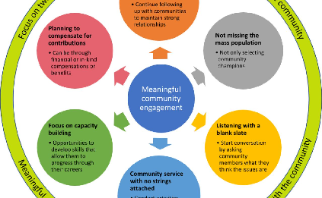
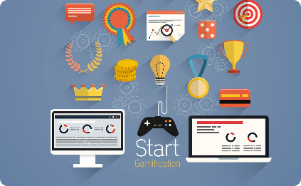
Public Information Web/App Interface
Interactive 3D Map
Community Engagement
Gamification
Create an immersive and user-friendly interactive 3D map that allows users to visualize real-time traffic conditions and plan their routes accordingly.
Incorporate gamification elements to incentivize responsible driving habits and promote awareness about traffic management strategies.
Enable users to actively participate by reporting incidents, uploading media files, and sharing their experiences through the app or website.

Slide 20
Conclusion
Connected vehicles, sustainability, and data privacy are transforming traffic management. Cloud-based platforms, drone-based monitoring, and crowdsourced data pave the way for efficient transportation. Optimizing routes, detecting congestion, and providing real-time public information enhance the traffic experience. Embracing innovation and collaboration is key to the future of traffic management.

